Slide 1
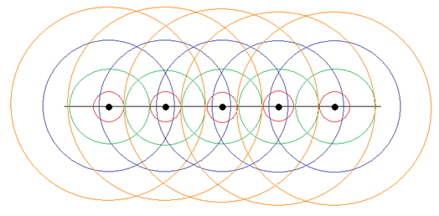
IV Frauhofer diffraction from slits
4-1. Huygens-Fresnel principle
Every unobstructed point of a wavefront, at a given instant in time, serves as a source of spherical secondary wavelets (with the same frequency as a source of spherical wave).
Proof:
http://www.spgindia.org/geohorizon/jan_2007/huygens_priciple.pdf

Slide 2
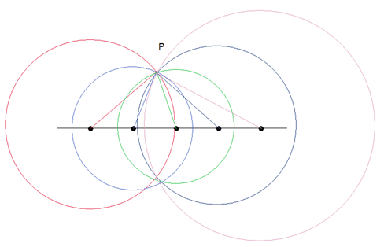
4-2. Superposition principle
The amplitude of the optical field at any point beyond is the superposition of the wavelets (considering their amplitudes and relative phases).

Slide 3
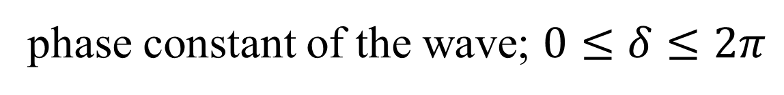
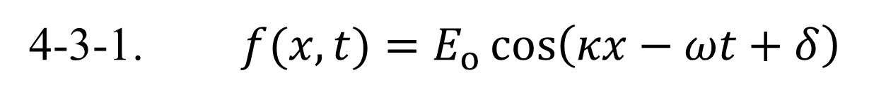
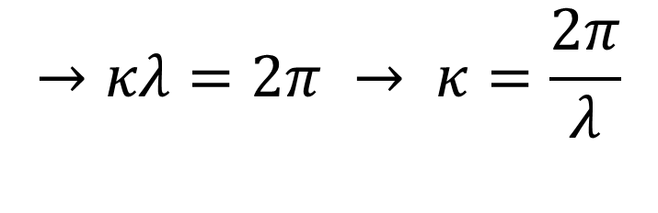
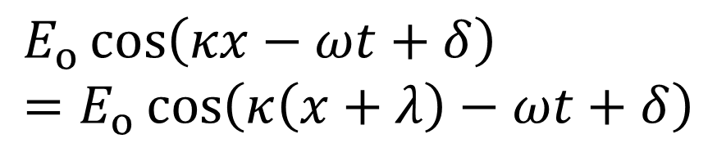

4-3. A wave in the complex notation
4-3-1. $f(x, t)=E_{o}\cos\left(κx−ωt+δ\right)$
wave number
amplitude
angular frequency
phase constant of the wave; $0≤δ≤2π$
$$f\left(x, t_{o}\right)=f\left(x+λ, t_{o}\right)$$
$$E_{o}\cos\left(κx−ωt+δ\right)=E_{o}\cos\left(κ\left(x+λ\right)−ωt+δ\right)$$
$$→κλ=2π → κ=\frac{2π}{λ}$$

Slide 4
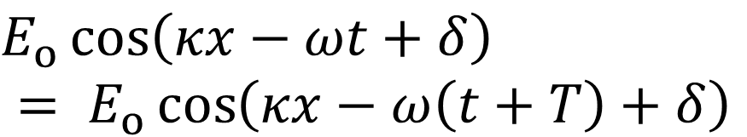



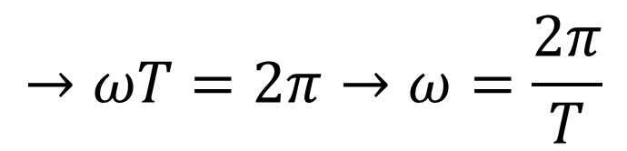
$$f\left(x, t_{o}\right)=f\left(x, t_{o}+T\right)$$
$E_{o}\cos\left(κx−ωt+δ\right)$
$$= E_{o}\cos\left(κx−ω\left(t+T\right)+δ\right)$$
$$→ωT=2π→ω=\frac{2π}{T}$$
$$ω=2πν$$
where $v=\frac{1}{T}$ is the frequency of the wave

Slide 5
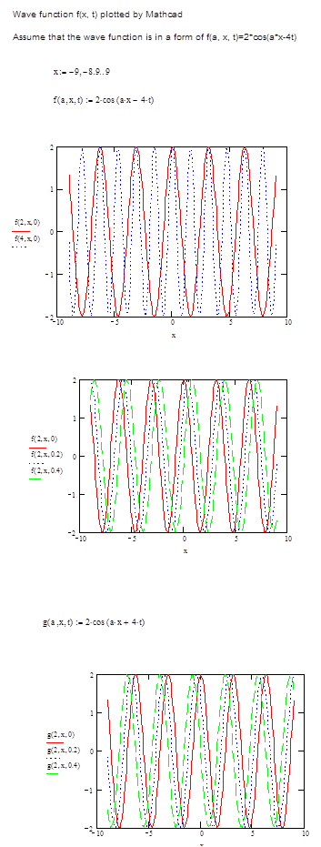




$$f\left(a,x, t\right)=2\cos\left(ax−4t\right)$$
$$x:−9,−8.9, …9$$
$$f\left(2,x, 0\right)$$
$$f\left(4,x, 0\right)$$

Slide 6
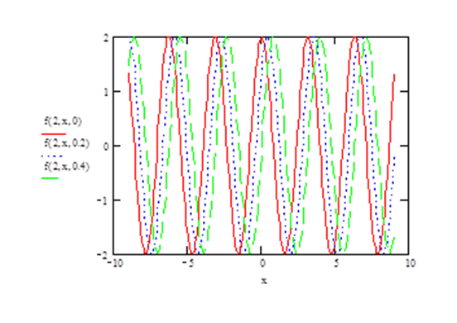



$$f\left(2,x, 0\right)$$
$$f\left(2,x, 0.2\right)$$
$$f\left(2,x, 0.4\right)$$

Slide 7




$$g\left(a,x, t\right)=2\cos\left(ax+4t\right)$$
$$g\left(2,x, 0\right)$$
$$g\left(2,x, 0.2\right)$$
$$g\left(2,x, 0.4\right)$$

Slide 8
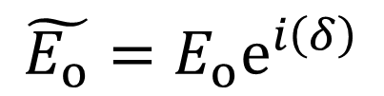

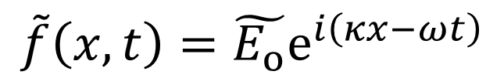


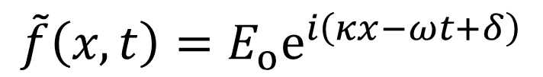
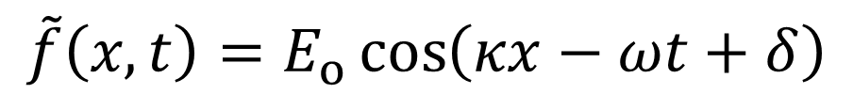
4-3-2. Complex notation
$$e^{ix}=\cos{x}+i\sin{x}$$
$$f\left(x, t\right)=E_{o}\cos\left(κx−ωt+δ\right)$$
$$\tilde{f}\left(x, t\right)=E_{o}\cos\left(κx−ωt+δ\right)$$
$$+E_{o}i\sin\left(κx−ωt+δ\right)$$
$$\tilde{f}\left(x, t\right)=E_{o}e^{i\left(κx−ωt+δ\right)}$$
define a complex wave function
$$\tilde{f}\left(x, t\right)=\tilde{E_{o}}e^{i\left(κx−ωt\right)}$$
where
$$\tilde{E_{o}}=E_{o}e^{i\left(δ\right)}$$

Slide 9
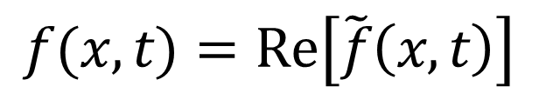

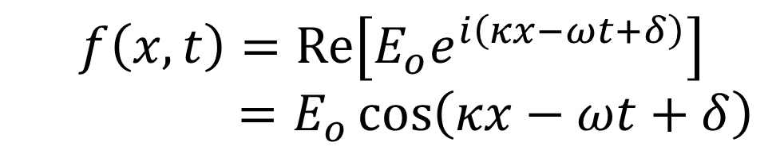
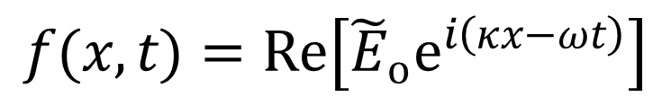
The real wave function can be obtained by taking the real part of $\tilde{f}\left(x, t\right)$
$$f(x, t)=Re\left[\tilde{f}\left(x, t\right)\right]$$
$$f(x, t)=Re\left[{\tilde{E}}_{o}e^{i\left(κx−ωt\right)}\right]$$
$$f\left(x, t\right)=Re\left[{E_{o}e}^{i\left(κx−ωt+δ\right)}\right]$$
$=E_{o}\cos\left(κx−ωt+δ\right)$

Slide 10
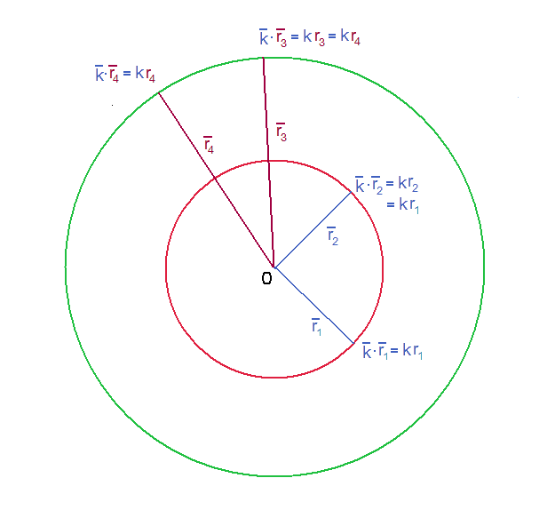
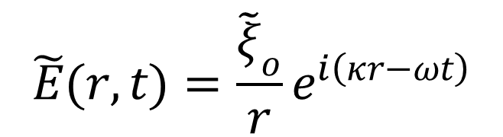
4-3-3. Spherical wave
$$\tilde{E}(r, t)=\frac{{\tilde{ξ}}_{o}}{r}e^{i\left(κr−ωt\right)}$$
Intensity is the energy
flux = energy/(m²sec)

Slide 11
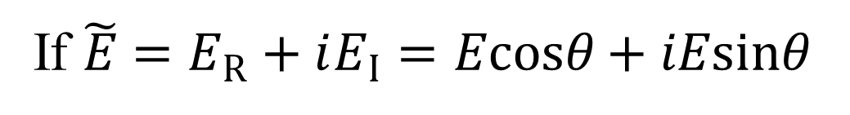

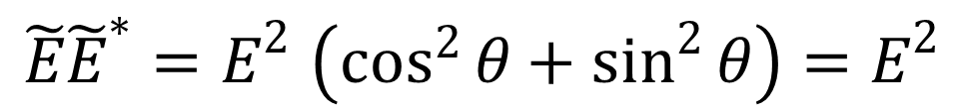
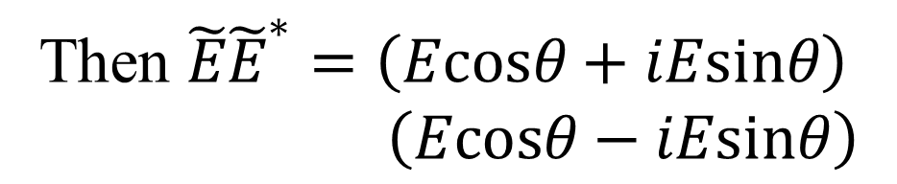
Intensity is proportional to $\tilde{E}{\tilde{E}}^{∗}$
If $\tilde{E}=E_{R}+iE_{I}=Ecosθ+iEsinθ$
Then $\tilde{E}{\tilde{E}}^{∗}=\left(Ecosθ+iEsinθ\right)$
$\left(Ecosθ−iEsinθ\right)$
$$\tilde{E}{\tilde{E}}^{∗}{=E}^{2}\left(\cos^{2}{θ}+\sin^{2}{θ}\right){=E}^{2}$$
→ energy is proportional to E²
→ Total energy is conserved
→ 4πr²*E² is a constant
→ E² is proportional to 1/r²
→ E is proportional to 1/r for a spherical wave

Slide 12
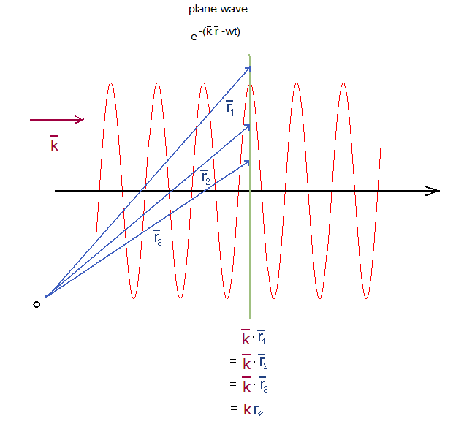

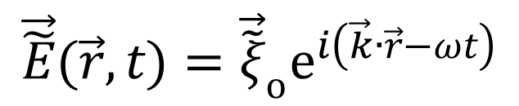



4-3-4. Plane wave
$$\vec{\tilde{E}}(\vec{r}, t)={\vec{\tilde{ξ}}}_{o}e^{i\left(\vec{k}∙\vec{r}−ωt\right)}$$
$$\vec{r}$$
$$\vec{r}$$
⊥
$$\vec{r}$$
$$\vec{k}$$
||

Slide 13
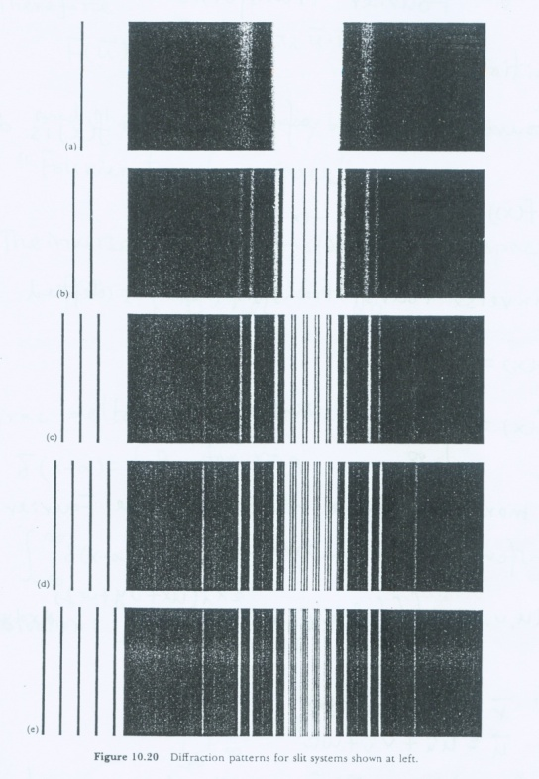
4-4. Frauhofer diffraction (far field diffraction)
Diffraction
patterns
from slits

Slide 14
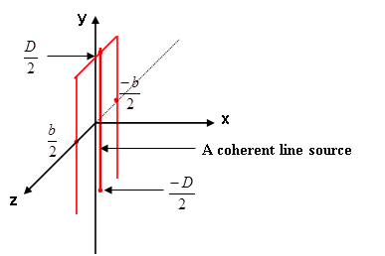
1、diffraction from a single slit

Slide 15
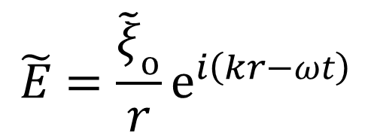
(1) consider diffraction from a coherent line source first.
y
D/2
P
r₁
θ
Δy_{i}
R
θ
x
ϕ
z
-D/2
According to Huygens-Fresnel principle, each
point emits a spherical wavelet
source strength
at each point
$$\tilde{E}=\frac{{\tilde{ξ}}_{o}}{r}e^{i\left(kr−ωt\right)}$$

Slide 16
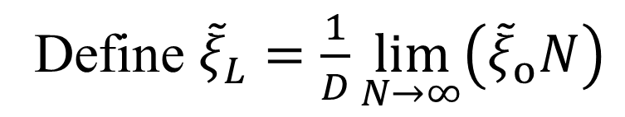
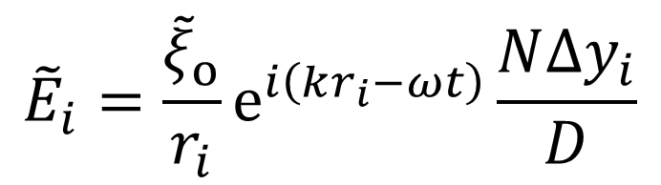
Suppose that
(a) N is the total number of the source;
(b) D is the width of the coherent line source;
(c) The line is divided into M segments，
i.e. i=1、2、3 ….i…..M
The contribution to the electric field at P from the ith segment is
$${\tilde{E}}_{i}=\frac{{\tilde{ξ}}_{o}}{r_{i}}e^{i\left(kr_{i}−ωt\right)}\frac{N{Δy}_{i}}{D}$$
source strength
per unite length
Define ${\tilde{ξ}}_{L}=\frac{1}{D}\lim_{N→∞}\left({\tilde{ξ}}_{o}N\right)$

Slide 17
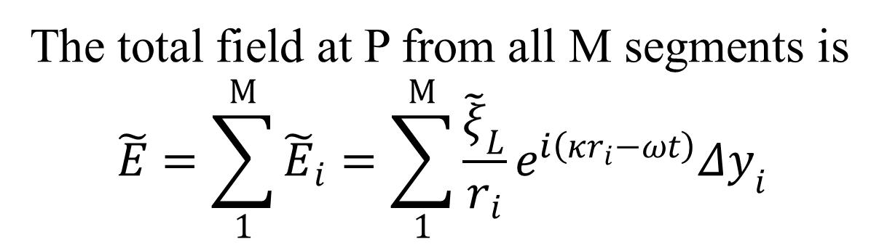
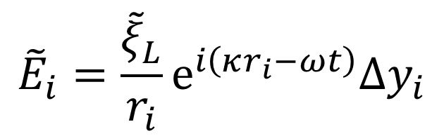
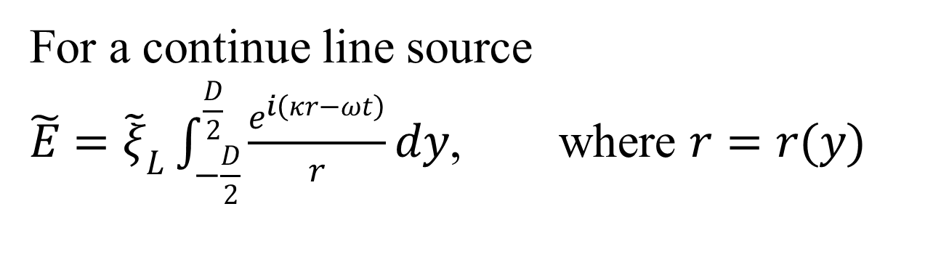
$${\tilde{E}}_{i}=\frac{{\tilde{ξ}}_{L}}{r_{i}}e^{i\left(κr_{i}−ωt\right)}Δy_{i}$$
The total field at P from all M segments is
$$\tilde{E}=\sum_{1}^{M}{{\tilde{E}}_{i}}=\sum_{1}^{M}{\frac{{\tilde{ξ}}_{L}}{r_{i}}e^{i\left(κr_{i}−ωt\right)}Δy_{i}}$$
For a continue line source
$\tilde{E}={\tilde{ξ}}_{L}\int_{−\frac{D}{2}}^{\frac{D}{2}}{\frac{e^{i\left(κr−ωt\right)}}{r}}dy$, where $r=r(y)$

Slide 18
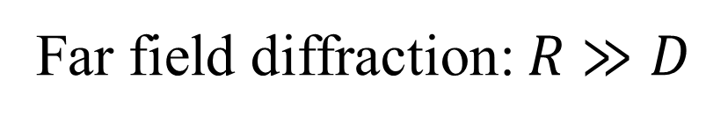
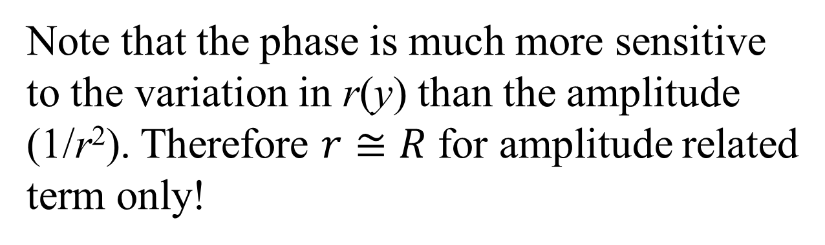
Far field diffraction: $R≫D$
Note that the phase is much more sensitive to the variation in r(y) than the amplitude (1/r²). Therefore $r≅R$ for amplitude related
term only!
The r in phase term has to be treated separately!

Slide 19
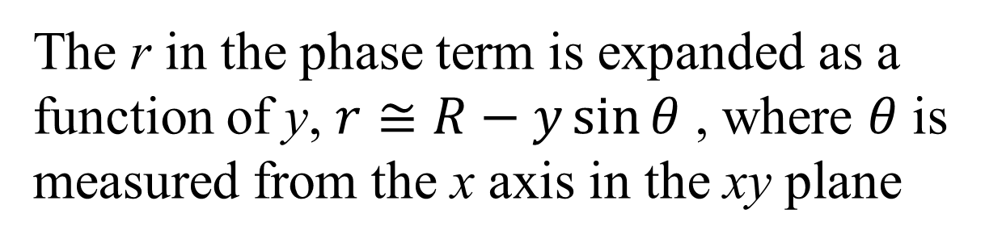
The r in the phase term is expanded as a function of y, $r≅R−y\sin{θ}$ , where $θ$ is measured from the x axis in the xy plane
y
r
P
y
ycosθ
θ
R
θ
x
ϕ
ysinθ
z
-D/2
$$r^{2}=\left(R−ysinθ\right)2+\left(ycosθ\right)2$$
$$r^{2}=R2−2Rysinθ+\left(ysinθ\right)2+\left(ycosθ\right)2$$
y²

Slide 20
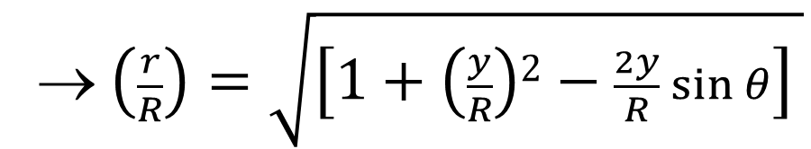
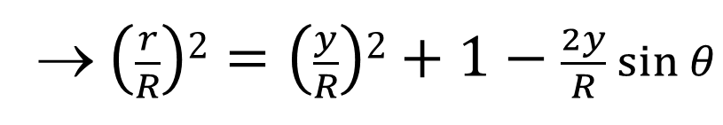
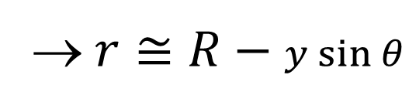
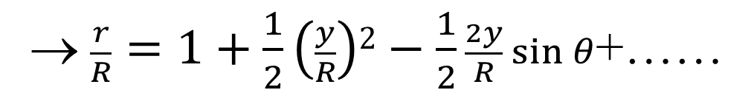
→ $\left(\frac{r}{R}\right)2=\left(\frac{y}{R}\right)2+1−\frac{2y}{R}\sin{θ}$
→ $\left(\frac{r}{R}\right)=\sqrt{\left[1+\left(\frac{y}{R}\right)2−\frac{2y}{R}\sin{θ}\right] }$
x, m = 0.5
Maclaurin series
$$\left(1+x\right)m=1+mx+\frac{m(m−1)}{2!}x2+ …..$$
→ $\frac{r}{R}=1+\frac{1}{2}\left(\frac{y}{R}\right)2−\frac{1}{2}\frac{2y}{R}\sin{θ}$+……
→ $r≅R−y\sin{θ}$

Slide 21
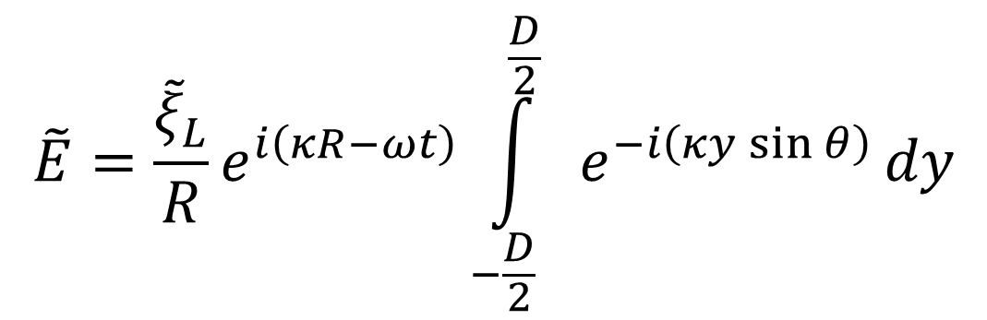
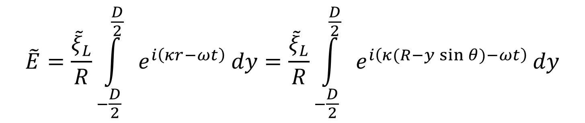
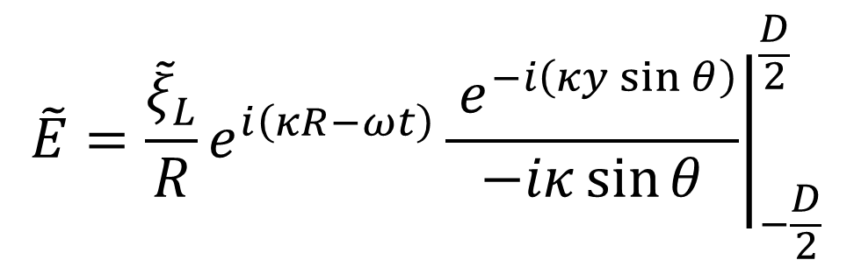
$$\tilde{E}=\frac{{\tilde{ξ}}_{L}}{R}\int_{−\frac{D}{2}}^{\frac{D}{2}}{ e^{i\left(κr−ωt\right)}}dy=\frac{{\tilde{ξ}}_{L}}{R}\int_{−\frac{D}{2}}^{\frac{D}{2}}{ e^{i\left(κ(R−y\sin{θ})−ωt\right)}}dy$$
R >> y
$$\tilde{E}=\frac{{\tilde{ξ}}_{L}}{R}e^{i\left(κR−ωt\right)}\int_{−\frac{D}{2}}^{\frac{D}{2}}{ e^{−i\left(κy\sin{θ}\right)}}dy$$
$$\tilde{E}=\frac{{\tilde{ξ}}_{L}}{R}e^{i\left(κR−ωt\right)}{\left.\frac{ e^{−i\left(κy\sin{θ}\right)}}{−iκ\sin{θ}}\right|}_{−\frac{D}{2}}^{\frac{D}{2}}$$

Slide 22
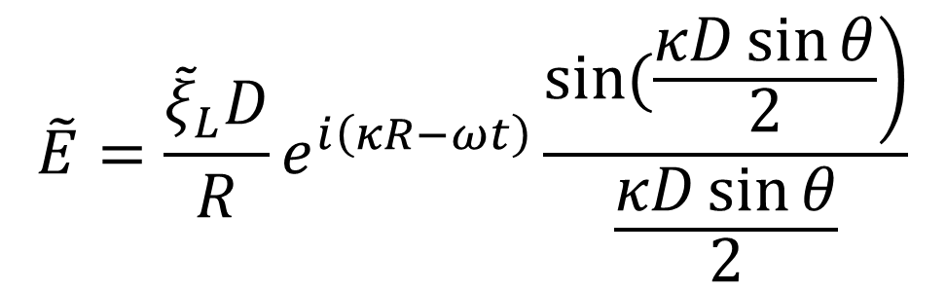
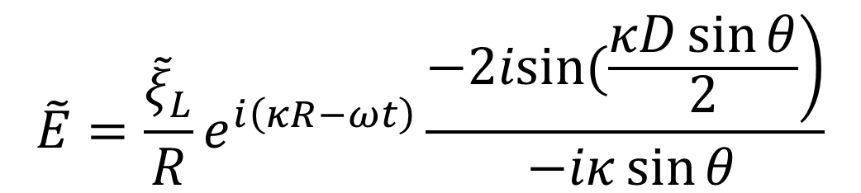

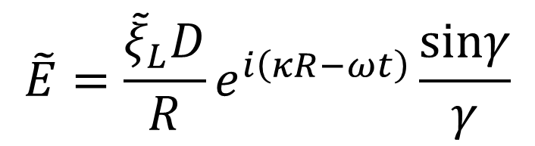
$$\tilde{E}=\frac{{\tilde{ξ}}_{L}}{R}e^{i\left(κR−ωt\right)}\frac{\left.−2isin(\frac{κD\sin{θ}}{2}\right)}{ −iκ\sin{θ}}$$
$$\tilde{E}=\frac{{\tilde{ξ}}_{L}D}{R}e^{i\left(κR−ωt\right)}\frac{\left.sin(\frac{κD\sin{θ}}{2}\right)}{\frac{κD\sin{θ}}{2}}$$
$$≡γ$$
$$\tilde{E}=\frac{{\tilde{ξ}}_{L}D}{R}e^{i\left(κR−ωt\right)}\frac{sinγ}{γ}$$

Slide 23
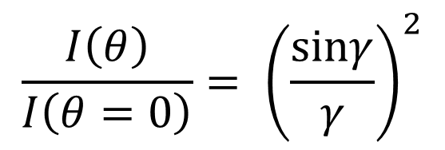
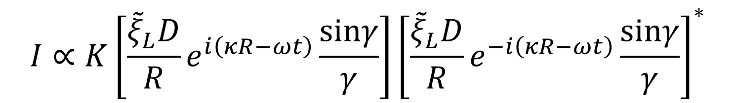
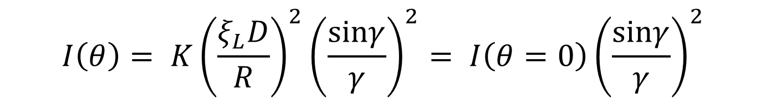
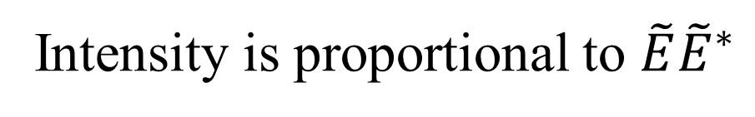
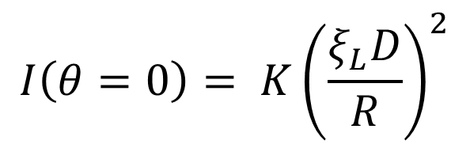


Intensity is proportional to $\tilde{E}{\tilde{E}}^{∗}$
$$I∝K\left[\frac{{\tilde{ξ}}_{L}D}{R}e^{i\left(κR−ωt\right)}\frac{sinγ}{γ}\right]{\left[\frac{{\tilde{ξ}}_{L}D}{R}e^{−i\left(κR−ωt\right)}\frac{sinγ}{γ}\right]}^{∗}$$
$$I∝{\left(\frac{ξ_{L}D}{R}\right)}^{2}{\left(\frac{sinγ}{γ}\right)}^{2}$$
$$I\left(θ=0\right)= K{\left(\frac{ξ_{L}D}{R}\right)}^{2}$$
when$θ→0$, $\frac{sinγ}{γ}→\frac{sin(0)}{0}=1$,
$$I\left(θ\right)= K{\left(\frac{ξ_{L}D}{R}\right)}^{2}{\left(\frac{sinγ}{γ}\right)}^{2}= I\left(θ=0\right){\left(\frac{sinγ}{γ}\right)}^{2}$$
$$\frac{I\left(θ\right)}{I\left(θ=0\right)}= {\left(\frac{sinγ}{γ}\right)}^{2}$$

Slide 24




$$γ=\frac{κD\sin{θ}}{2}=\frac{2π}{λ}\frac{D\sin{θ}}{2}=\frac{πD\sin{θ}}{λ}$$
Discussion:
when $D≫λ$, γ → ∞, sinγ/γ → 0 (at θ ≠ 0)
$$I\left(θ=0\right)=K{\left(\frac{ξ_{L}D}{R}\right)}^{2}$$
$$I\left(θ≠0\right)=0$$
its emission resembles a circular wave in xz plane
y
θ
x
z

Slide 25



when $λ≫D$, γ → 0, sinγ/γ → 1 (at θ ≠ 0)
$$I\left(θ=0\right)=K{\left(\frac{ξ_{L}D}{R}\right)}^{2}$$
$$I\left(θ≠0\right)=K{\left(\frac{ξ_{L}D}{R}\right)}^{2}$$
=
the line source resembles a point source emitting spherical waves.
y
θ ≠ 0
θ = 0
x
z

Slide 26




(2) consider diffraction from a single slit
$\left.\tilde{E}(r, t\right)$ field in the xz plane
$$\tilde{E}=\frac{{\tilde{ξ}}_{L}^{′}}{R}\int_{−\frac{b}{2}}^{\frac{b}{2}}{ e^{i\left(κr−ωt\right)}}dz$$
source strength
per unite length
$${\tilde{ξ}}_{L}^{′}$$

Slide 27



$$r=r(z)≅R−z\sin{θ}$$
measured from the x
axis in the xz plane
Exactly the same as previous case except xy
plane → xz plane and D → b!
$$\tilde{E}=\frac{{\tilde{ξ}}_{L}^{′}}{R}\int_{−\frac{b}{2}}^{\frac{b}{2}}{ e^{i\left(κr−ωt\right)}}dz=\frac{{\tilde{ξ}}_{L}^{′}}{R}\int_{−\frac{b}{2}}^{\frac{b}{2}}{ e^{i\left(κ\left(R−z\sin{θ}\right)−ωt\right)}}dz$$
R >> z
$$\tilde{E}=\frac{{\tilde{ξ}}_{L}^{′}}{R}e^{i\left(κR−ωt\right)}\int_{−\frac{b}{2}}^{\frac{b}{2}}{ e^{−i\left(κz\sin{θ}\right)}}dz$$

Slide 28







$$\tilde{E}=\frac{{\tilde{ξ}}_{L}^{′}}{R}e^{i\left(κR−ωt\right)}{\left.\frac{ e^{−i\left(κz\sin{θ}\right)}}{−iκ\sin{θ}}\right|}_{−\frac{b}{2}}^{\frac{b}{2}}$$
$$\tilde{E}=\frac{{\tilde{ξ}}_{L}^{′}b}{R}e^{i\left(κR−ωt\right)}\frac{\left.sin(\frac{κb\sin{θ}}{2}\right)}{\frac{κb\sin{θ}}{2}}$$
≡ β
$$\tilde{E}=\frac{{\tilde{ξ}}_{L}^{′}b}{R}e^{i\left(κR−ωt\right)}\frac{sinβ}{β}$$
→ $I= K′{\left(\frac{ξ_{L}^{′}b}{R}\right)}^{2}{\left(\frac{sinβ}{β}\right)}^{2}$
$$I=K′ \tilde{E}{\tilde{E}}^{∗}$$
$$I\left(θ=0\right)= K′{\left(\frac{ξ_{L}^{′}b}{R}\right)}^{2}$$
when$θ→0$, $\frac{sinβ}{β}→\frac{sin(0)}{0}=1$,

Slide 29



$$I\left(θ\right)= K′{\left(\frac{ξ_{L}^{′}b}{R}\right)}^{2}{\left(\frac{sinβ}{β}\right)}^{2}= I\left(θ=0\right){\left(\frac{sinβ}{β}\right)}^{2}$$
$$\frac{I\left(θ\right)}{I\left(θ=0\right)}= {\left(\frac{sinβ}{β}\right)}^{2}$$
where $β=\frac{κb\sin{θ}}{2}=\frac{2π}{λ}\frac{b\sin{θ}}{2}=\frac{πb\sin{θ}}{λ}$

Slide 30




$$β=nπ→\frac{\sin{θ}}{λ}=\frac{n}{b}$$
$${\left(\frac{\sin{β}}{β}\right)}^{2}$$
$$β=π$$
$$\frac{β}{π}$$
b ↓ → minimum broadens

Slide 31

(3) diffraction from many slits

Slide 32



Based on the superposition principle, the total field strength from N slits is
$\tilde{E}=\frac{{\tilde{ξ}}_{L}^{′}}{R}\int_{−\frac{b}{2}}^{\frac{b}{2}}{ e^{i\left(κr−ωt\right)}}dz+\frac{{\tilde{ξ}}_{L}^{′}}{R}\int_{a−\frac{b}{2}}^{a+\frac{b}{2}}{ e^{i\left(κr−ωt\right)}}dz+\frac{{\tilde{ξ}}_{L}^{′}}{R}\int_{2a−\frac{b}{2}}^{2a+\frac{b}{2}}{ e^{i\left(κr−ωt\right)}}dz+ ∙∙∙+$ $\frac{{\tilde{ξ}}_{L}^{′}}{R}\int_{(N−1)a−\frac{b}{2}}^{(N−1)a+\frac{b}{2}}{ e^{i\left(κr−ωt\right)}}dz$
$$\frac{{\tilde{ξ}}_{L}^{′}}{R}\int_{−\frac{b}{2}}^{\frac{b}{2}}{e^{i\left(κ(R−zsinθ)−ωt\right)}dz}=\frac{{\tilde{ξ}}_{L}^{′}}{R}e^{i\left(κR−ωt\right)}\int_{−\frac{b}{2}}^{\frac{b}{2}}{e^{−iκzsinθ}dz}$$
$${\left.\frac{ e^{−iκz\sin{θ}}}{−iκ\sin{θ}}\right|}_{−\frac{b}{2}}^{\frac{b}{2}}=\frac{e^{−iκb\sin{θ}/2}−e^{iκb\sin{θ}/2}}{−iksinθ}=\frac{−2isin(kbsinθ/2)}{−iksinθ}$$

Slide 33


$$\frac{{\tilde{ξ}}_{L}^{′}}{R}\int_{a−\frac{b}{2}}^{a+\frac{b}{2}}{e^{i\left(κ(R−zsinθ)−ωt\right)}dz}$$
$$=\frac{{\tilde{ξ}}_{L}^{′}}{R}e^{i\left(κR−ωt\right)}\int_{a−\frac{b}{2}}^{a+\frac{b}{2}}{e^{−iκzsinθ}dz}$$
$${\left.\frac{ e^{−iκz\sin{θ}}}{−iκ\sin{θ}}\right|}_{a−\frac{b}{2}}^{a+\frac{b}{2}}=\frac{e^{−iκ(a+b/2)\sin{θ}}−e^{−iκ(a−b/2)\sin{θ}}}{−iksinθ}$$
$$=\frac{−2isin(kbsinθ/2)}{−iksinθ}e^{−iκa\sin{θ}}$$

Slide 34
Define

Slide 35
Define

Slide 36
=1
=1
where

Slide 37


When θ → 0; α, β → 0
For the multiple slit pattern:
For the diffraction in a crystal:
atomic spacing = a
atomic size = b
$$a>b$$
$$a≫b$$

Slide 38
$$β=nπ→\frac{\sin{θ}}{λ}=\frac{n}{b}$$
$${\left(\frac{\sin{β}}{β}\right)}^{2}$$
$$β=π$$
$$\frac{β}{π}$$
b ↓ → minimum broadens

Slide 39

N = 1

Slide 40

N = 2
N = 3

Slide 41

N = 4
N = 6

Slide 42

N = 100

Slide 43

N = 4
N = 4
a = 2b
a = 4b

Slide 44

N = 2
a = 4b

Slide 45
N = 3
a = 4b

Slide 46

N = 5
a = 4b

Slide 47
N = 100
a = 4b

Slide 48
Note that a is the spacing between adjacent slit (equivalent to a one-dimensional periodic structure)
The periodic maximum occurs at
There exists a one-dimensional periodic structure
in the space of sinθ/λ (= momentum k space)
Next chapter
similar
Bragg’s law

